Slide 1

Chapter 5 Network Layer:
Control Plane
Computer Networking: A Top-Down Approach 8th edition Jim Kurose, Keith Ross Pearson, 2020
Acknowledgement: Based on the textbook’s website: https://gaia.cs.umass.edu/kurose_ross/index.php
Notes:
Version History
8.0 (May 2020)
All slides reformatted for 16:9 aspect ratio
All slides updated to 8th edition material
Use of Calibri font, rather that Gill Sans MT
Add LOTS more animation throughout
lighter header font
Re-do of network management slides; redo of Bellman-Ford slides
8.2 (changes over 8.0)
improved animations of Dijkstra’s algorithm and Bellman Ford
various improvements to BGP
SDN: added Google Orion (2021 Google network SDN control plane)

Slide 2

Network layer: “control plane” roadmap
introduction
routing protocols
intra-ISP routing: OSPF
routing among ISPs: BGP
SDN control plane
Internet Control Message Protocol
network management, configuration
SNMP
NETCONF/YANG

Slide 3
What is network management?
autonomous systems (aka “network”): 1000s of interacting hardware/software components
other complex systems requiring monitoring, configuration, control:
jet airplane, nuclear power plant, others?
"Network management includes the deployment, integration
and coordination of the hardware, software, and human
elements to monitor, test, poll, configure, analyze, evaluate,
and control the network and element resources to meet the
real-time, operational performance, and Quality of Service
requirements at a reasonable cost."

Slide 4

Components of network management
Managed device: equipment with manageable, configurable hardware, software components
Managing server: application, typically with network
managers (humans) in the loop
agent
data
managing
server/controller
data
managed device
Data: device “state” configuration data, operational data, device statistics
agent
data
Network management protocol: used by managing server to query, configure, manage device; used by devices to inform managing server of data, events.
agent
data
managed device
managed device
agent
data
agent
data
managed device
managed device

Slide 5
Network operator approaches to management
CLI (Command Line Interface)
operator issues (types, scripts) direct to individual devices (e.g., vis ssh)
agent
data
managing
server/controller
SNMP/MIB
operator queries/sets devices data (MIB) using Simple Network Management Protocol (SNMP)
data
managed device
agent
data
agent
data
NETCONF/YANG
more abstract, network-wide, holistic
emphasis on multi-device configuration management.
YANG: data modeling language
NETCONF: communicate YANG-compatible actions/data to/from/among remote devices
managed device
managed device
agent
data
agent
data
managed device
managed device

Slide 6
SNMP protocol
Two ways to convey MIB info, commands:
data
data
managing
server/controller
managing
server/controller
request
response
trap message
agent
data
agent
data
managed device
managed device
request/response mode
trap mode

Slide 7
SNMP protocol: message types
Message type
Function
GetRequest
GetNextRequest
GetBulkRequest
manager-to-agent: “get me data”
(data instance, next data in list,
block of data).
SetRequest
manager-to-agent: set MIB value
Response
Agent-to-manager: value, response to Request
Trap
Agent-to-manager: inform manager
of exceptional event

Slide 8
SNMP protocol: message formats
Get/set header
Variables to get/set
PDU
type
(0-3)
Error
Status
(0-5)
message types 0-3
Request
ID
Error
Index
Name
Value
Name
Value
….
Trap header
Trap info
PDU
type
4
Trap
Type
(0-7)
message type 4
Enterprise
Agent
Addr
Specific
code
Time
stamp
Name
Value
….
SNMP PDU

Slide 9
SNMP: Management Information Base (MIB)
managed device’s operational (and some configuration) data
gathered into device MIB module
400 MIB modules defined in RFC’s; many more vendor-specific MIBs
agent
data
Structure of Management Information (SMI): data definition language
example MIB variables for UDP protocol:
Object ID Name Type Comments
1.3.6.1.2.1.7.1 UDPInDatagrams 32-bit counter total # datagrams delivered
1.3.6.1.2.1.7.2 UDPNoPorts 32-bit counter # undeliverable datagrams (no application at port)
1.3.6.1.2.1.7.3 UDInErrors 32-bit counter # undeliverable datagrams (all other reasons)
1.3.6.1.2.1.7.4 UDPOutDatagrams 32-bit counter total # datagrams sent
1.3.6.1.2.1.7.5 udpTable SEQUENCE one entry for each port currently in use

Slide 10
NETCONF overview
goal: actively manage/configure devices network-wide
operates between managing server and managed network devices
actions: retrieve, set, modify, activate configurations
atomic-commit actions over multiple devices
query operational data and statistics
subscribe to notifications from devices
remote procedure call (RPC) paradigm
NETCONF protocol messages encoded in XML
exchanged over secure, reliable transport (e.g., TLS) protocol

Slide 11
NETCONF initialization, exchange, close
managing
server/controller
agent
data
Session initiation,
capabilities exchange: <hello>
data
<rpc>
…
<rpc-reply>
…
…
<rpc>
<rpc-reply>
…
…
<notification>
…
…
<rpc>
<rpc-reply>
…
…
Session close: <close-session>

Slide 12
Selected NETCONF Operations
NETCONF Operation Description
<get-config> Retrieve all or part of a given configuration. A device may have multiple configurations.
<get> Retrieve all or part of both configuration state and operational state data.
<edit-config> Change specified (possibly running) configuration at managed device. Managed device <rpc-reply> contains <ok> or <rpcerror> with rollback.
<lock>, <unlock> Lock (unlock) configuration datastore at managed device (to lock out NETCONF, SNMP, or CLIs commands from other sources).
<create-subscription>, Enable event notification subscription from managed device
<notification>

Slide 13
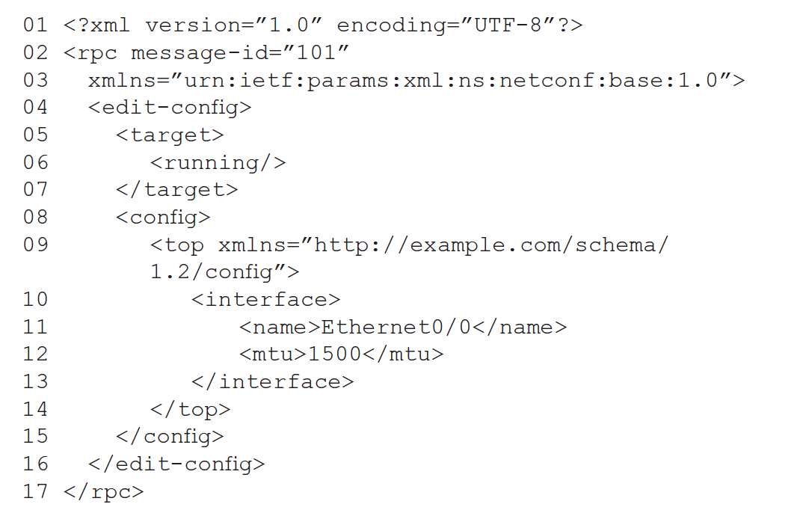
Sample NETCONF RPC message
note message id
change a configuration
change the running configuration
change MTU of Ethernet 0/0 interface to 1500

Slide 14
YANG
data modeling language used to specify structure, syntax, semantics of NETCONF network management data
built-in data types, like SMI
XML document describing device, capabilities can be generated from YANG description
can express constraints among data that must be satisfied by a valid NETCONF configuration
ensure NETCONF configurations satisfy correctness, consistency constraints
data
managing
server/controller
NETCONF RPC message
<edit-config>
YANG-generated XML
</edit-config>
YANG
generated
agent
data

Slide 15
Network layer: Summary
we’ve learned a lot!
approaches to network control plane
per-router control (traditional)
logically centralized control (software defined networking)
traditional routing algorithms
implementation in Internet: OSPF , BGP
SDN controllers
implementation in practice: ODL, ONOS
Internet Control Message Protocol
network management
next stop: link layer!

Slide 16
Network layer, control plane: Done!
introduction
routing protocols
link state
distance vector
intra-ISP routing: OSPF
routing among ISPs: BGP
SDN control plane
Internet Control Message Protocol
network management, configuration
SNMP
NETCONF/YANG

